Slide 1
XML
Structural Data in Pure Text
Service-Oriented Software Engineering
Software Institute
Nanjing University
Bei Jia

Slide 2
What Is XML?
At its core XML is text formatted to follow a well-defined set of rules.
XML documents consist primarily of tags and text.
This text may be stored/represented in:
  A normal file stored on disk
  A message being sent over HTTP
  A character string in a programming language
  A CLOB (character large object) in a database
  Any other way textual data can be used
XML documents do not need to exist as documents. For simplicity they will be referred to as though they are documents and files. --they may be:
  Byte streams sent between applications
  Fields in a database record
  Collections of XML Infoset information items

Slide 3
Example Tree Representation of XML
XML documents should be thought of as a hierarchical tree structure.

Slide 4
Basic Structure

Slide 5
Basics of Well-formed XML
XML documents are considered to be well-formed when they adhere to a set of five rules that define basic XML syntax and structure + a sixth for worldwide conformity.
  Single root element
  Element Tag Rules
  Element Nesting Rules
  Element Rules
  Element Attribute
  XML Declaration

Slide 6
1. Single Root Element
All XML documents must have a single root element.

Slide 7
2. Element Tag Rules

Slide 8
3. Element Nesting
Elements must be properly nested.
  The end tags of inner elements must occur before the end tags of outer elements.
Any number of child elements or data may be nested within the start and end tags of an element.

Slide 9
4. Element Rules : XML Naming (1/2)
XML name construction:
  The first character must be A-Z, a-z, or _ (underscore)
  Any number of subsequent letters, numbers, hyphens, periods, colons, and underscore characters.
  XML names are case sensitive.
  Names cannot contain spaces.
    Names must not have a prefix of xml in any case combination (such names are reserved).

Slide 10
4. Element Rules : XML Naming (2/2)
Tag Naming - Samples

Slide 11
4. Element Rules : Element Content
(General)
An XML instance is composed of elements expressed in tag pairs (except for empty tags) plus optional attributes that always have quoted values and optional data that appears between the element start tag and the element end tag.
Mixed content - element content that contains data (PCDATA is shown) and other elements.

Slide 12
4. Element Rules : Element Content (Data)
Element data content is handled in one of two ways:
  1. Parsed Character Data (PCDATA): is examined by the XML parser to discover XML content embedded within it.
  2. Character Data (CDATA): is delimited by the special syntax <![CDATA[ ... ]]> and is not processed by the parser.

Slide 13
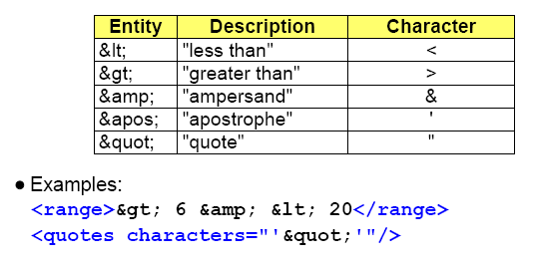
4. Element Rules :
PCDATA - Parsed Character Data
Predefined entities exist to address ambiguous syntax situations, situations where the literal would be interpreted as part of the XML document syntax rather than its content.

Slide 14
4. Element Rules :
CDATA - Character Data
Syntax:
  Note: Anything except the literal string "]]>"; to embed "]]>" use "]]&gt;"
CDATA is not parsed and is treated as-is.
Useful for embedding other languages within the XML.
  HTML documents.
  XML documents.
  JavaScript source.
  Or any other text with a lot of special characters.
Generally speaking the escaping rules inside a CDATA section are those of the embedded language
  For example, to escape an ampersand in Javascript use &#38;.

Slide 15
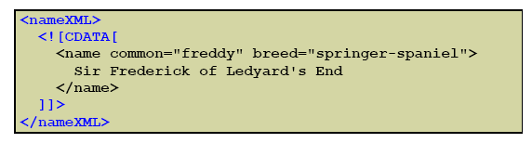
4. Element Rules :
CDATA - Character Data (Cont.)
These script elements contain JavaScript:
This nameXML element stores actual XML to be treated as text:

Slide 16
5. Element Attributes
Attributes are used to attach information to elements.
Attributes consist of a name="value" pair, where the name is a legal XML name. This is often referred to as a "key-value" pair.
Attributes are placed in the start tag of the element to which they apply.
An element may have several attributes, each uniquely named.
Examples:
Notice the different usage of the attribute "type" in the two elements; semantically they are not the same.
Attributes must have a value.
Values must be quoted with either double or single quotes.

Slide 17
6. XML Declaration
The XML Declaration is an optional first line in all XML documents:
  If this declaration is used, the version attribute is mandatory.
  The encoding attribute indicates the character encoding used in the document; if UTF-8 or UTF-16 is used it may be omitted.
  The stand-alone attribute is included here for completeness: it is used to indicate if this XML document depends on information declared externally to this document; value may be yes or no.
  Comments are not allowed before this statement.
  The XML Declaration follows the syntax of a Processing Instruction or PI, but it is considered to be unique and is treated separately in the 1.0 XML specification.

Slide 18
Comments
<!-- --> Defines a comment.
A space after the beginning and before the trailing hyphens is recommended but not required.
Improper usage:

Slide 19
Processing Instruction
Syntax <? target arg*?>
Processing Instruction is often abbreviated as PI in documentation.
A feature inherited from SGML.
Used to embed application-specific instructions in documents.
The target name immediately follows "<?" and is used to associate the PI with an application.
May include zero or more arguments.
May be preceded by comments.
For example,
which is a generally available stylesheet for simple formatting.

Slide 20
Well-formed versus Valid
A well-formed XML document:
  Consists of XML elements that are nested within another.
  Has a unique root element.
  Follows the XML naming conventions.
  Follows the XML rules for quoting attributes.
  Has tags that are properly terminated.
All XML parsers check for well-formedness.
A valid XML document has an associated vocabulary and obeys the structural rules specified by that vocabulary.
  Associated vocabulary is typically defined by either a DTD or an XML Schema.
  XML parsers may be validating or non-validating depending upon whether or not they can apply an associated grammar.

